Slide 1
IPv6 Network Addresses
Notes:
8.2 IPv6 Network Addresses

Slide 2
IPv4 Issues The Need for IPv6
IPv6 is designed to be the successor to IPv4.
Depletion of IPv4 address space has been the motivating factor for moving to IPv6.
Projections show that all five RIRs will run out of IPv4 addresses between 2015 and 2020.
With an increasing Internet population, a limited IPv4 address space, issues with NAT and an Internet of things, the time has come to begin the transition to IPv6!
IPv4 has a theoretical maximum of 4.3 billion addresses, plus private addresses in combination with NAT.
IPv6 larger 128-bit address space provides for 340 undecillion addresses.
IPv6 fixes the limitations of IPv4 and includes additional enhancements, such as ICMPv6.
Notes:
8.2.1.1 The Need for IPv6

Slide 3
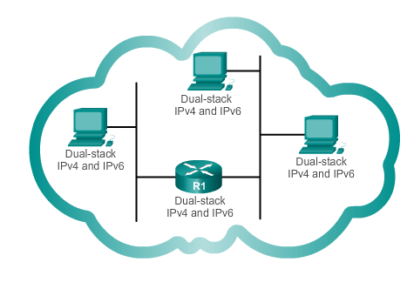
IPv4 Issues IPv4 and IPv6 Coexistence
The migration techniques can be divided into three categories:
Dual-stack, Tunnelling, and Translation.
Dual-stack
Dual-stack: Allows IPv4 and IPv6 to coexist on the same network. Devices run both IPv4 and IPv6 protocol stacks simultaneously.
Notes:
8.2.1.2 IPv4 and IPv6 Coexistence

Slide 4
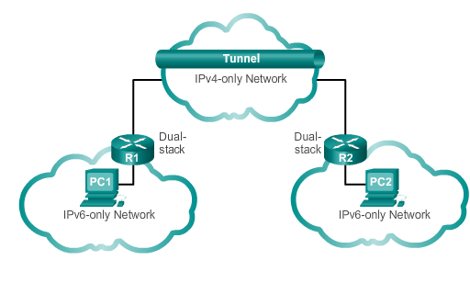
IPv4 Issues IPv4 and IPv6 Coexistence (cont.)
Tunnelling
Tunnelling: A method of transporting an IPv6 packet over an IPv4 network. The IPv6 packet is encapsulated inside an IPv4 packet.
Notes:
8.2.1.2 IPv4 and IPv6 Coexistence

Slide 5
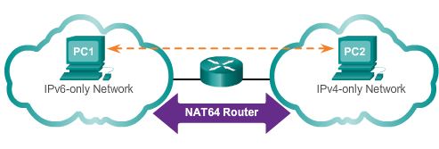
IPv4 Issues IPv4 and IPv6 Coexistence (cont.)
Translation
Translation: The Network Address Translation 64 (NAT64) allows IPv6-enabled devices to communicate with IPv4-enabled devices using a translation technique similar to NAT for IPv4. An IPv6 packet is translated to an IPv4 packet, and vice versa.
Notes:
8.2.1.2 IPv4 and IPV6 Coexistence (cont.)

Slide 6
IPv6 Addressing IPv6 Address Representation
128 bits in length and written as a string of hexadecimal values
In IPv6, 4 bits represents a single hexadecimal digit, 32 hexadecimal value = IPv6 address
2001:0DB8:0000:1111:0000:0000:0000:0200
FE80:0000:0000:0000:0123:4567:89AB:CDEF
Hextet used to refer to a segment of 16 bits or four hexadecimals
Can be written in either lowercase or uppercase
Notes:
8.2.2.2 IPv6 Address Representation

Slide 7

IPv6 Addressing Rule 1- Omitting Leading 0s
The first rule to help reduce the notation of IPv6 addresses is any leading 0s (zeros) in any 16-bit section or hextet can be omitted.
01AB can be represented as 1AB.
09F0 can be represented as 9F0.
0A00 can be represented as A00.
00AB can be represented as AB.
Notes:
8.2.2.3 Rule 1 – Omitting Leading 0s

Slide 8
IPv6 Addressing Rule 2 - Omitting All 0 Segments
A double colon (::) can replace any single, contiguous string of one or more 16-bit segments (hextets) consisting of all 0’s.
Double colon (::) can only be used once within an address otherwise the address will be ambiguous.
Known as the compressed format.
Incorrect address - 2001:0DB8::ABCD::1234.
Notes:
8.2.2.4 Rule 2 – Omitting All 0 Segments

Slide 9
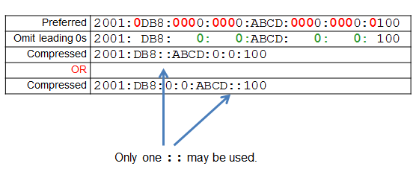
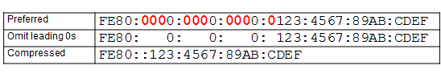
IPv6 Addressing Rule 2 - Omitting All 0 Segments (cont.)
Example #1
Example #2
Notes:
8.2.2.4 Rule 2 – Omitting All 0 Segments (cont.)

Slide 10
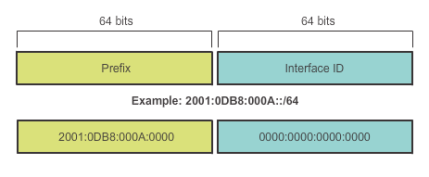
Types of IPv6 Addresses IPv6 Prefix Length
IPv6 does not use the dotted-decimal subnet mask notation
Prefix length indicates the network portion of an IPv6 address using the following format:
IPv6 address/prefix length
Prefix length can range from 0 to 128
Typical prefix length is /64
Notes:
8.2.3.2 IPv6 Prefix Length

Slide 11
Types of IPv6 Addresses IPv6 Address Types
There are three types of IPv6 addresses:
Unicast
Multicast
Anycast.
Note: IPv6 does not have broadcast addresses.
Notes:
8.2.3.1 IPv6 Address Types

Slide 12
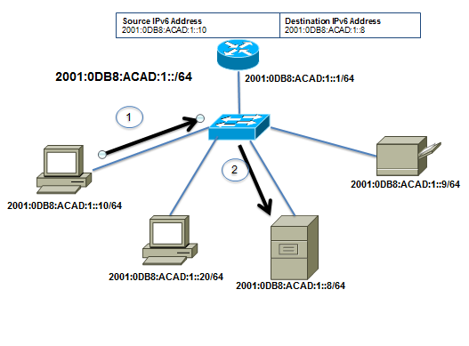
Types of IPv6 Addresses IPv6 Unicast Addresses
Unicast
Uniquely identifies an interface on an IPv6-enabled device.
A packet sent to a unicast address is received by the interface that is assigned that address.
Notes:
8.2.3.1/8.2.3.3 IPv6 Unicast Addresses

Slide 13
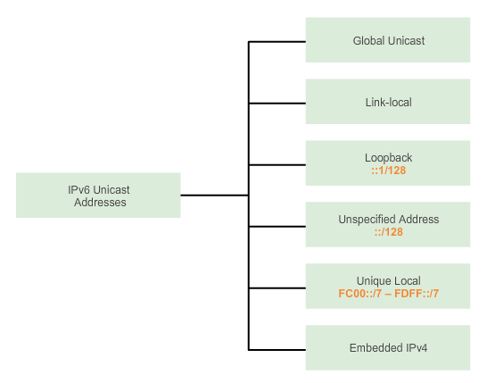
Types of IPv6 Addresses IPv6 Unicast Addresses (cont.)
Notes:
8.2.3.3 IPv6 Unicast Addresses (cont.)

Slide 14
Types of IPv6 Addresses IPv6 Unicast Addresses (cont.)
Global Unicast
Similar to a public IPv4 address
Globally unique
Internet routable addresses
Can be configured statically or assigned dynamically
Link-local
Used to communicate with other devices on the same local link
Confined to a single link; not routable beyond the link
Notes:
8.2.3.3 IPv6 Unicast Addresses (cont.)

Slide 15
Types of IPv6 Addresses IPv6 Unicast Addresses (cont.)
Loopback
Used by a host to send a packet to itself and cannot be assigned to a physical interface.
Ping an IPv6 loopback address to test the configuration of TCP/IP on the local host.
All-0s except for the last bit, represented as ::1/128 or just ::1.
Unspecified Address
All-0’s address represented as ::/128 or just ::
Cannot be assigned to an interface and is only used as a source address.
An unspecified address is used as a source address when the device does not yet have a permanent IPv6 address or when the source of the packet is irrelevant to the destination.
Notes:
8.2.3.3 IPv6 Unicast Addresses (cont.)

Slide 16
Types of IPv6 Addresses IPv6 Unicast Addresses (cont.)
Unique Local
Similar to private addresses for IPv4.
Used for local addressing within a site or between a limited number of sites.
In the range of FC00::/7 to FDFF::/7.
IPv4 Embedded
Used to help transition from IPv4 to IPv6.
Notes:
8.2.3.3 IPv6 Unicast Addresses (cont.)

Slide 17
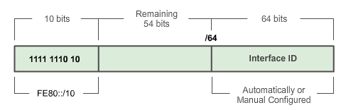
Types of IPv6 Addresses IPv6 Link-Local Unicast Addresses
Add a header
Every IPv6-enabled network interface is REQUIRED to have a link-local address
Enables a device to communicate with other IPv6-enabled devices on the same link and only on that link (subnet)
FE80::/10 range, first 10 bits are 1111 1110 10xx xxxx
1111 1110 1000 0000 (FE80) - 1111 1110 1011 1111 (FEBF)
Notes:
8.2.3.4 IPv6 Link-Local Unicast Addresses

Slide 18
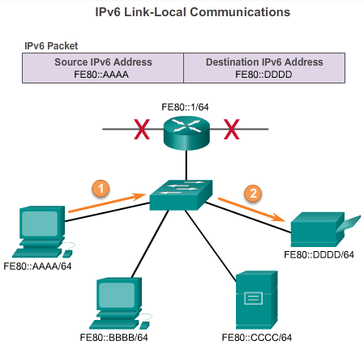
Types of IPv6 Addresses IPv6 Link-Local Unicast Addresses (cont.)
Packets with a source or destination link-local address cannot be routed beyond the link from where the packet originated.
Notes:
8.2.3.4 IPv6 Link-Local Unicast Addresses

Slide 19
IPv6 Unicast Addresses Structure of an IPv6 Global Unicast Address
IPv6 global unicast addresses are globally unique and routable on the IPv6 Internet
Equivalent to public IPv4 addresses
ICANN allocates IPv6 address blocks to the five RIRs
Notes:
8.2.4.1 Structure of an IPv6 Global Unicast Address

Slide 20
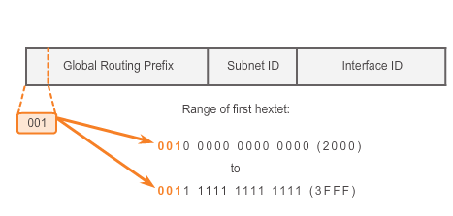
IPv6 Unicast Addresses Structure of an IPv6 Global Unicast Address (cont.)
Currently, only global unicast addresses with the first three bits of 001 or 2000::/3 are being assigned
Notes:
8.2.4.1 Structure of an IPv6 Global Unicast Address (cont.)

Slide 21
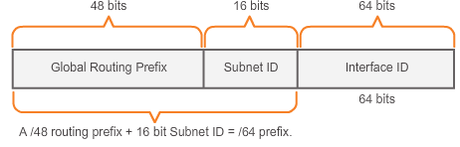
IPv6 Unicast Addresses Structure of an IPv6 Global Unicast Address (cont.)
A global unicast address has three parts: Global Routing Prefix, Subnet ID, and Interface ID.
Global Routing Prefix is the prefix or network portion of the address assigned by the provider, such as an ISP, to a customer or site, currently, RIR’s assign a /48 global routing prefix to customers.
2001:0DB8:ACAD::/48 has a prefix that indicates that the first 48 bits (2001:0DB8:ACAD) is the prefix or network portion.
Notes:
8.2.4.1 Structure of an IPv6 Global Unicast Address (cont.)

Slide 22
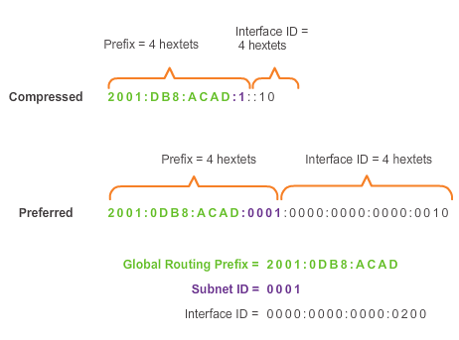
IPv6 Unicast Addresses Structure of an IPv6 Global Unicast Address (cont.)
Subnet ID is used by an organization to identify subnets within its site
Interface ID
Equivalent to the host portion of an IPv4 address.
Used because a single host may have multiple interfaces, each having one or more IPv6 addresses.
Notes:
8.2.4.1 Structure of an IPv6 Global Unicast Address

Slide 23
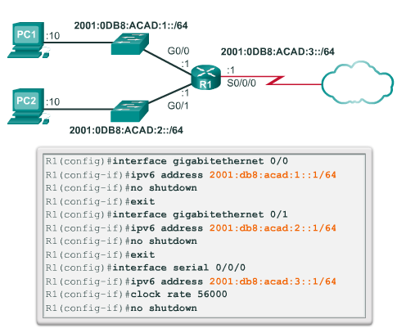
IPv6 Unicast Addresses Static Configuration of a Global Unicast Address
Notes:
8.2.4.2 Static Configuration of a Global Unicast Address

Slide 24
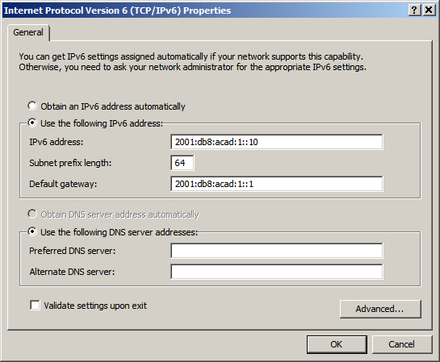
IPv6 Unicast Addresses Static Configuration of an IPv6 Global Unicast Address (cont.)
Windows IPv6 Setup
Notes:
8.2.4.2 Static Configuration of an IPv6 Global Unicast Address (cont.)

Slide 25
IPv6 Unicast Addresses Dynamic Configuration of a Global Unicast Address using SLAAC
Stateless Address Autoconfiguraton (SLAAC)
A method that allows a device to obtain its prefix, prefix length and default gateway from an IPv6 router
No DHCPv6 server needed
Rely on ICMPv6 Router Advertisement (RA) messages
IPv6 routers
Forwards IPv6 packets between networks
Can be configured with static routes or a dynamic IPv6 routing protocol
Sends ICMPv6 RA messages
Notes:
8.2.4.3 Dynamic Configuration of a Global Unicast Address using SLAAC

Slide 26
IPv6 Unicast Addresses Dynamic Configuration of a Global Unicast Address using SLAAC (cont.)
The IPv6 unicast-routing command enables IPv6 routing.
RA message can contain one of the following three options:
SLAAC Only – Uses the information contained in the RA message.
SLAAC and DHCPv6 – Uses the information contained in the RA message and get other information from the DHCPv6 server, stateless DHCPv6 (for example, DNS).
DHCPv6 only – The device should not use the information in the RA, stateful DHCPv6.
Routers send ICMPv6 RA messages using the link-local address as the source IPv6 address
Notes:
8.2.4.3 Dynamic Configuration of a Global Unicast Address using SLAAC (cont.)

Slide 27
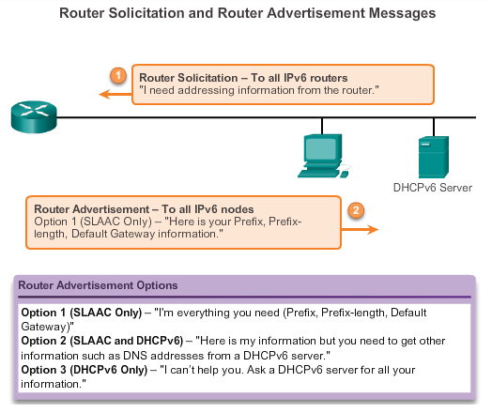
IPv6 Unicast Addresses Dynamic Configuration of a Global Unicast Address using SLAAC (cont.)
Notes:
8.2.4.3 Dynamic Configuration of a Global Unicast Address using SLAAC (cont.)

Slide 28
IPv6 Unicast Addresses Dynamic Configuration of a Global Unicast Address using DHCPv6 (cont.)
Dynamic Host Configuration Protocol for IPv6 (DHCPv6)
Similar to IPv4
Automatically receives addressing information, including a global unicast address, prefix length, default gateway address and the addresses of DNS servers using the services of a DHCPv6 server.
Device may receive all or some of its IPv6 addressing information from a DHCPv6 server depending upon whether option 2 (SLAAC and DHCPv6) or option 3 (DHCPv6 only) is specified in the ICMPv6 RA message.
Host may choose to ignore whatever is in the router’s RA message and obtain its IPv6 address and other information directly from a DHCPv6 server.
Notes:
8.2.4.4 Dynamic Configuration of a Global Unicast Address using DHCPv6 (cont.)

Slide 29
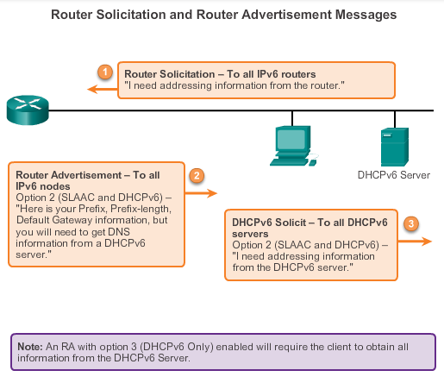
IPv6 Unicast Addresses Dynamic Configuration of a Global Unicast Address using DHCPv6 (cont.)
Notes:
8.2.4.4 Dynamic Configuration of a Global Unicast Address using DHCPv6 (cont.)

Slide 30
IPv6 Unicast Addresses EUI-64 Process or Randomly Generated
EUI-64 Process
Uses a client’s 48-bit Ethernet MAC address and inserts another 16 bits in the middle of the 46-bit MAC address to create a 64-bit Interface ID.
Advantage is that the Ethernet MAC address can be used to determine the interface; is easily tracked.
EUI-64 Interface ID is represented in binary and comprises three parts:
24-bit OUI from the client MAC address, but the 7th bit (the Universally/Locally bit) is reversed (0 becomes a 1).
Inserted as a 16-bit value FFFE.
24-bit device identifier from the client MAC address.
Notes:
8.2.4.5 EUI-64 Process or Randomly Generated

Slide 31
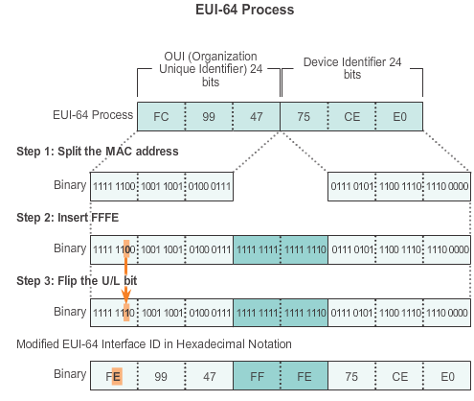
IPv6 Unicast Addresses EUI-64 Process or Randomly Generated (cont.)
Notes:
8.2.4.5 EUI-64 Process or Randomly Generated

Slide 32
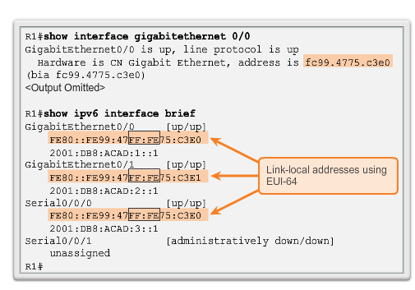
IPv6 Unicast Addresses EUI-64 Process or Randomly Generated (cont.)
Notes:
8.2.4.5 EUI-64 Process or Randomly Generated (cont.)

Slide 33
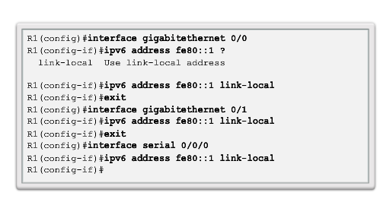
IPv6 Unicast Addresses Static Link-local Addresses
Configuring Link-local
Notes:
8.2.4.7 Static Link-local Addresses

Slide 34
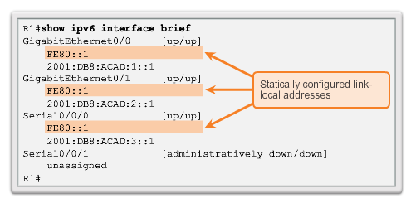
IPv6 Unicast Addresses Static Link-local Addresses (cont.)
Configuring Link-local
Notes:
8.2.4.7 Static Link-local Addresses (cont.)

Slide 35
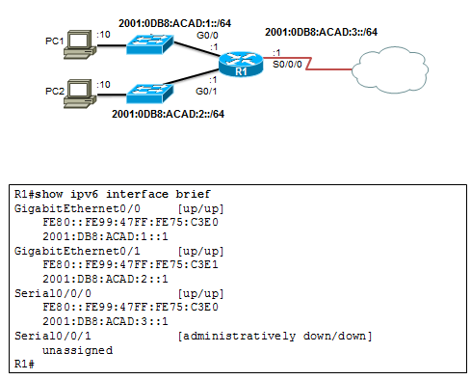
IPv6 Global Unicast Addresses Verifying IPv6 Address Configuration
Each interface has two IPv6 addresses -
global unicast address that was configured
one that begins with FE80 is automatically added as a link-local unicast address
Notes:
8.2.4.8 Verifying IPv6 Address Configuration

Slide 36
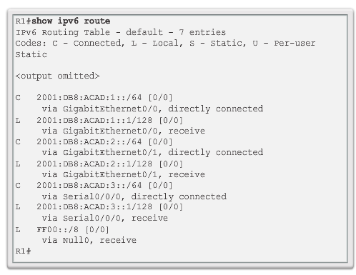
IPv6 Global Unicast Addresses Verifying IPv6 Address Configuration (cont.)
Notes:
8.2.4.8 Verifying IPv6 Address Configuration (cont.)

Slide 37
IPv6 Multicast Addresses Assigned IPv6 Multicast Addresses
IPv6 multicast addresses have the prefix FF00::/8
There are two types of IPv6 multicast addresses:
Assigned multicast
Solicited node multicast
Notes:
8.2.5.1 Assigned IPv6 Multicast Addresses

Slide 38
IPv6 Multicast Addresses Assigned IPv6 Multicast Addresses (cont.)
Two common IPv6 assigned multicast groups include:
FF02::1 All-nodes multicast group –
All IPv6-enabled devices join
Same effect as an IPv4 broadcast address
FF02::2 All-routers multicast group
All IPv6 routers join
A router becomes a member of this group when it is enabled as an IPv6 router with the ipv6 unicast-routing global configuration mode command.
A packet sent to this group is received and processed by all IPv6 routers on the link or network.
Notes:
8.2.5.1 Assigned IPv6 Multicast Addresses (cont.)

Slide 39
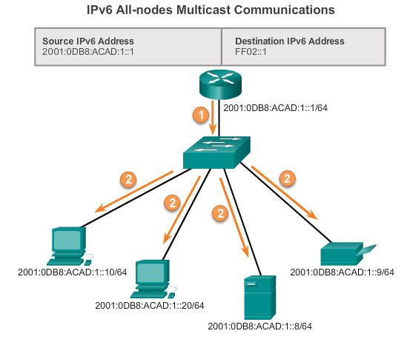
IPv6 Multicast Addresses Assigned IPv6 Multicast Addresses (cont.)
Notes:
8.2.5.1 Assigned IPv6 Multicast Addresses (cont.)

Slide 40
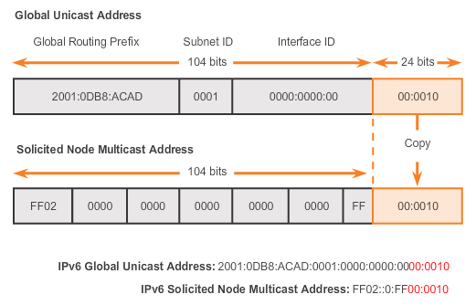
IPv6 Multicast Addresses Solicited Node IPv6 Multicast Addresses
Similar to the all-nodes multicast address, matches only the last 24 bits of the IPv6 global unicast address of a device
Automatically created when the global unicast or link-local unicast addresses are assigned
Created by combining a special FF02:0:0:0:0:0:FF00::/104 prefix with the right-most 24 bits of its unicast address
Notes:
8.2.5.2 Solicited Node IPv6 Multicast Addresses

Slide 41
IPv6 Multicast Addresses Solicited Node IPv6 Multicast Addresses (cont.)
The solicited node multicast address consists of two parts:
FF02:0:0:0:0:0:FF00::/104 multicast prefix – First 104 bits of the all solicited node multicast address
Least significant 24-bits – Copied from the right-most 24 bits of the global unicast or link-local unicast address of the device
Notes:
8.2.5.2 Solicited Node IPv6 Multicast Addresses (cont.)

Slide 42
8.3 Connectivity Verification
Notes:
8.3 Connectivity Verification

Slide 43
ICMP ICMPv4 and ICMPv6 Messages
ICMP messages common to both ICMPv4 and ICMPv6 include:
Host confirmation
Destination or Service Unreachable
Time exceeded
Route redirection
Although IP is not a reliable protocol, the TCP/IP suite does provide for messages to be sent in the event of certain errors, sent using the services of ICMP.
Notes:
8.3.1.1 ICMPv4 and ICMPv6 Messages

Slide 44
ICMP ICMPv6 Router Solicitation and Router Advertisement Messages
ICMPv6 includes four new protocols as part of the Neighbor Discovery Protocol (ND or NDP):
Router Solicitation message
Router Advertisement message
Neighbor Solicitation message
Neighbor Advertisement message
Router Solicitation and Router Advertisement Message – Sent between hosts and routers.
Router Solicitation (RS) message – RS messages are sent as an IPv6 all-routers multicast message.
Router Advertisement (RA) message – RA messages are sent by routers to provide addressing information.
Notes:
8.3.1.2 ICMPv6 Router Solicitation and Router Advertisement Messages

Slide 45
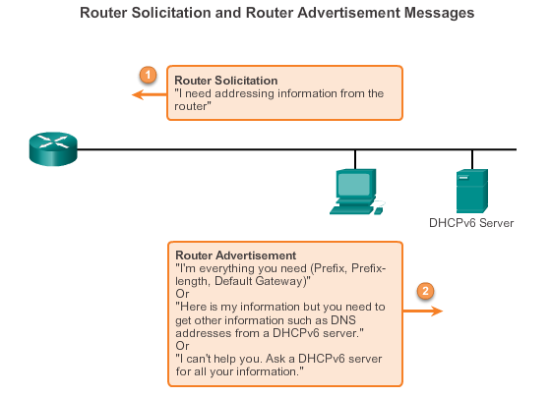
ICMP ICMPv6 Router Solicitation and Router Advertisement Messages (cont.)
Notes:
8.3.1.2 ICMPv6 Router Solicitation and Router Advertisement Messages (cont.)

Slide 46
ICMP ICMPv6 Neighbor Solicitation and Neighbor Advertisement Messages
Two additional message types:
Neighbor Solicitation (NS)
Neighbor Advertisement (NA) messages
Used for address resolution is used when a device on the LAN knows the IPv6 unicast address of a destination, but does not know its Ethernet MAC address.
Also used for Duplicate Address Detection (DAD)
Performed on the address to ensure that it is unique.
The device sends an NS message with its own IPv6 address as the targeted IPv6 address.
Notes:
8.3.1.3 ICMPv6 Neighbor Solicitation and Neighbor Advertisement Messages

Slide 47
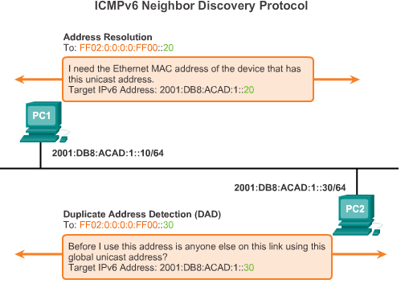
ICMP ICMPv6 Neighbor Solicitation and Neighbor Advertisement Messages (cont.)
Notes:
8.3.1.3 ICMPv6 Neighbor Solicitation and Neighbor Advertisement Messages (cont.)

